Slide 1
Exercises for Risk Assessment Focused on Process Safety
Rohan Perera & Han-Gi Kim
Feburary 6, 2020

Slide 2
Workshop # 1 Process Technology
- 2 -

Slide 3
Workshop 1 – Hydrogeneration Process (Process Technology)
Situation:
You are a technical supervisor responsible for support of the batch production area. Process A (a batch process) has been established and has run for 10 years.
A newly developed process B offers a lower cost and improved quality incentives.
The process equipment remains unchanged from the equipment used in process A.
The operating procedures are the same, except for operating temperatures.
A test authorization is proposed to permit operation of process B in the plant.

Slide 4
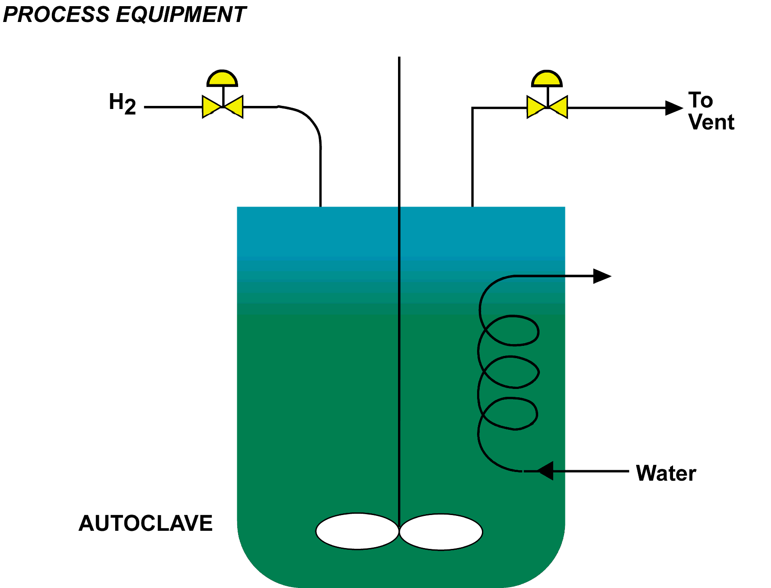
Workshop 1 – Hydrogeneration Process

Slide 5
Workshop 1 – Hydrogeneration Process
Chemistry:
Problem:
What information would you require in a PT package?
Group Discussion 20’

Slide 6
Workshop # 2 Process Hazard Analysis
- 6 -

Slide 7
Workshop 2 – Sealless Pump (PHA)
Situation:
You are a production supervisor responsible for several batch operations. One of these operations is a batch reaction of organic chemicals in Isopropyl alcohol solvent at 60°C.
A test authorization was prepared and authorized to test the proposed use of a sealless pump.
A PHA was conducted and documented on the pump, and an operating procedure was prepared and authorized for the process described in the sketch.
The test was unsuccessful; the pump failed. Another candidate sealless pump is proposed that uses the same equipment setup and an identical operating procedure.

Slide 8
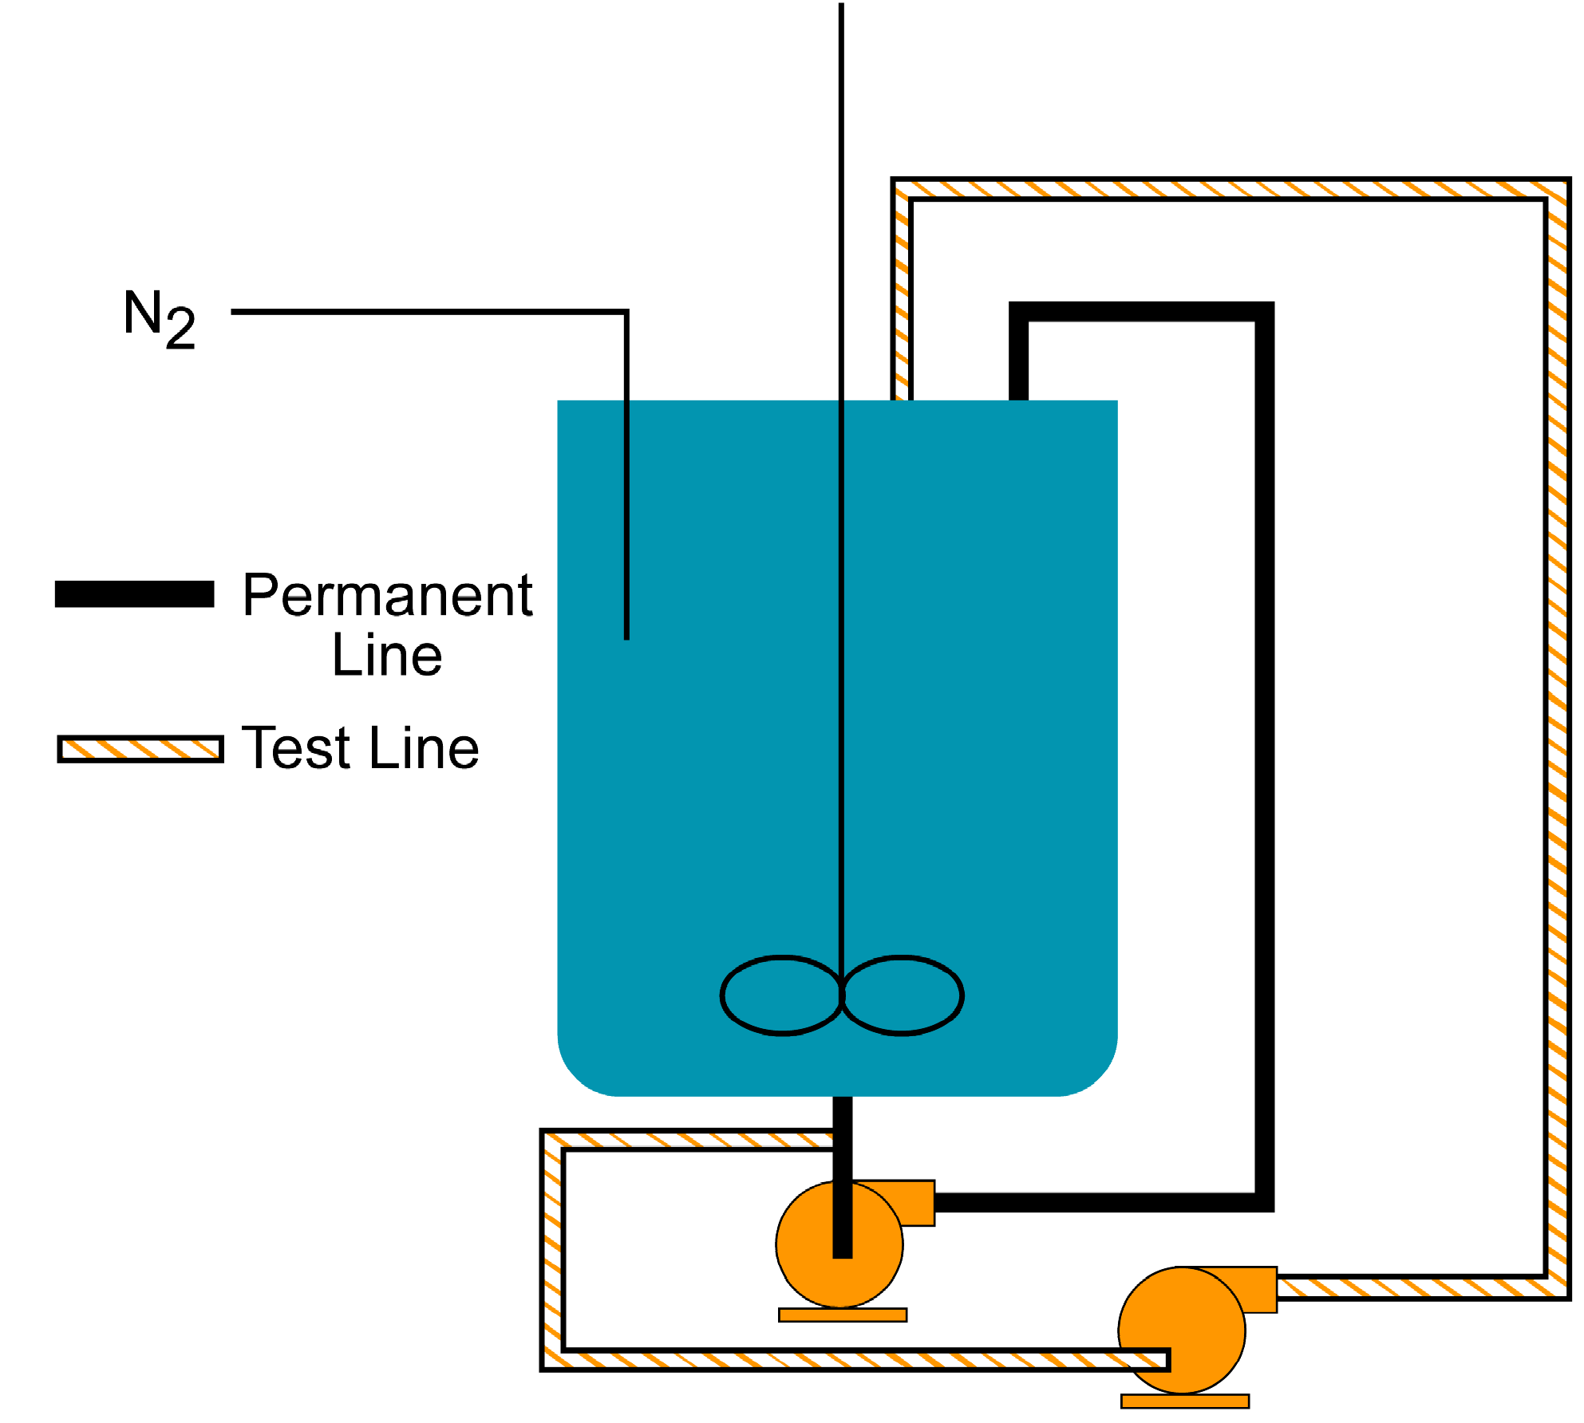
Workshop 2 – Sealless Pump

Slide 9
Workshop 2 – Sealless Pump
Problem:
Should you conduct another PHA on this process?
Explain the reasons for your response.
If a PHA is to be done, who should be on the team, and how long should the review take?
Can the consequence analysis from the first PHA be duplicated for the second PHA?
Group Discussion 20’

Slide 10
Workshop # 3 MOC-Technology
- 10 -

Slide 11
Workshop 3 – Nitrobody Distillation (MOC - T)
Situation:
You are an operations superintendent responsible for the Nitrobody distillation process, distilling 2-chloro-4-nitrotoluene. This process has been incident-free for 10 years. The need for distilled Nitrobody now exceeds still capacity. A second still is proposed for the additional capacity needed. The proposed still has been routinely used for Nitrobody distillations and has identical distillation columns but different heating systems. A test authorization is proposed.
Problem:
Would you require a PHA before authorizing this test?
If your answer is ”yes”, what questions would you expect to raise in the review?
Group Discussion 20’

Slide 12
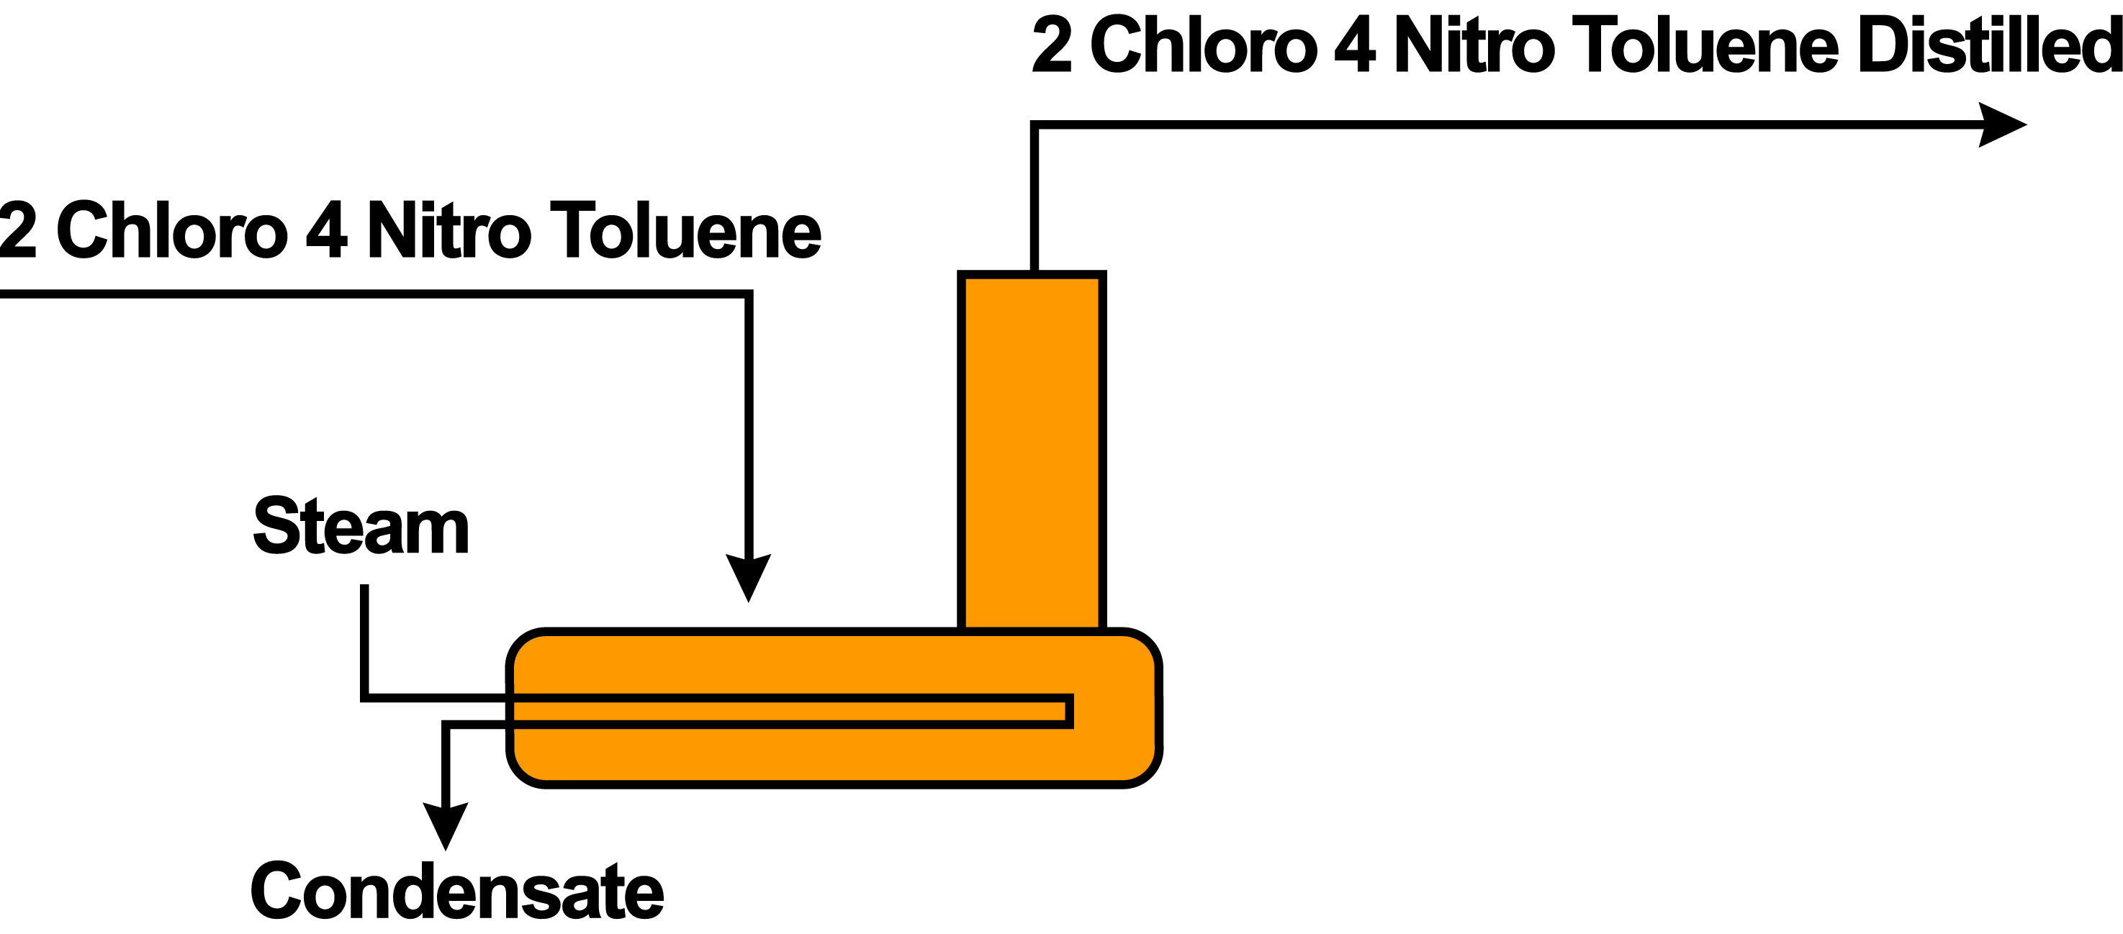
Workshop 3 – Nitrobody Distillation
Process Equipment

Slide 13
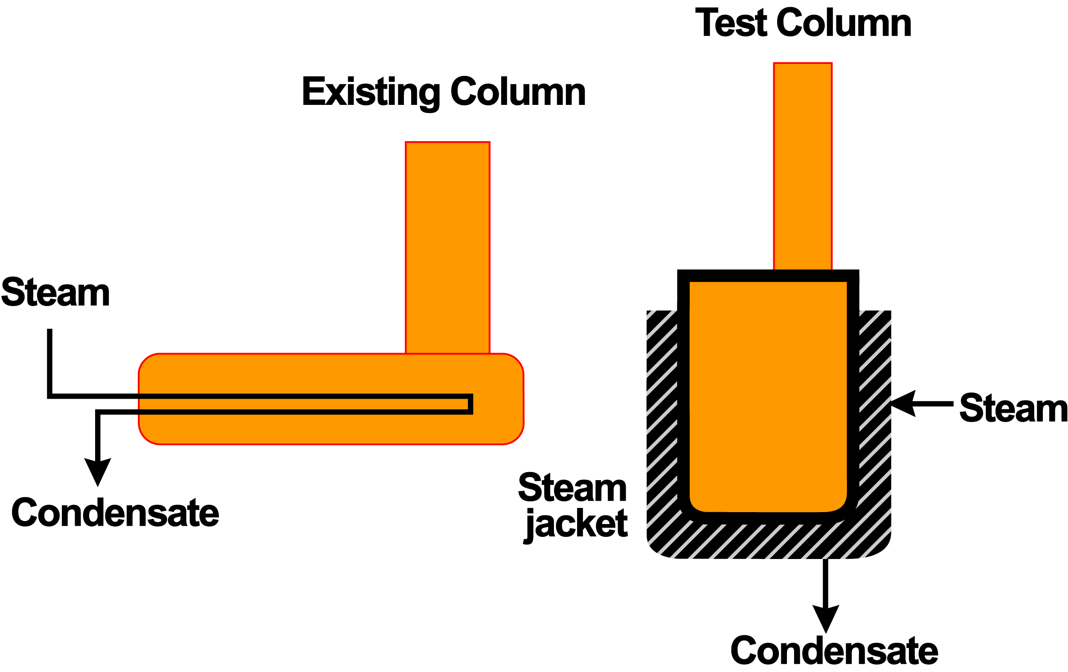
Workshop 3 – Nitrobody Distillation
Process Equipment

Slide 14
Workshop # 4 Quality Assurance
- 14 -

Slide 15
Workshop 4 – Quality Assurance (QA)
Situation:
You are the lead project liaison person for a new cogeneration power plant being installed at your plant site. One of the pieces of this project is a 300-foot , 30-inch diameter pipeline that will carry high-pressure steam from a boiler to steam turbine.
The line is to be run past the existing boiler control building, as shown in the sketch.
Problem:
List the steps you think should be taken to ensure that the quality of this pipe is as specified in the project.
Group Discussion 20’

Slide 16
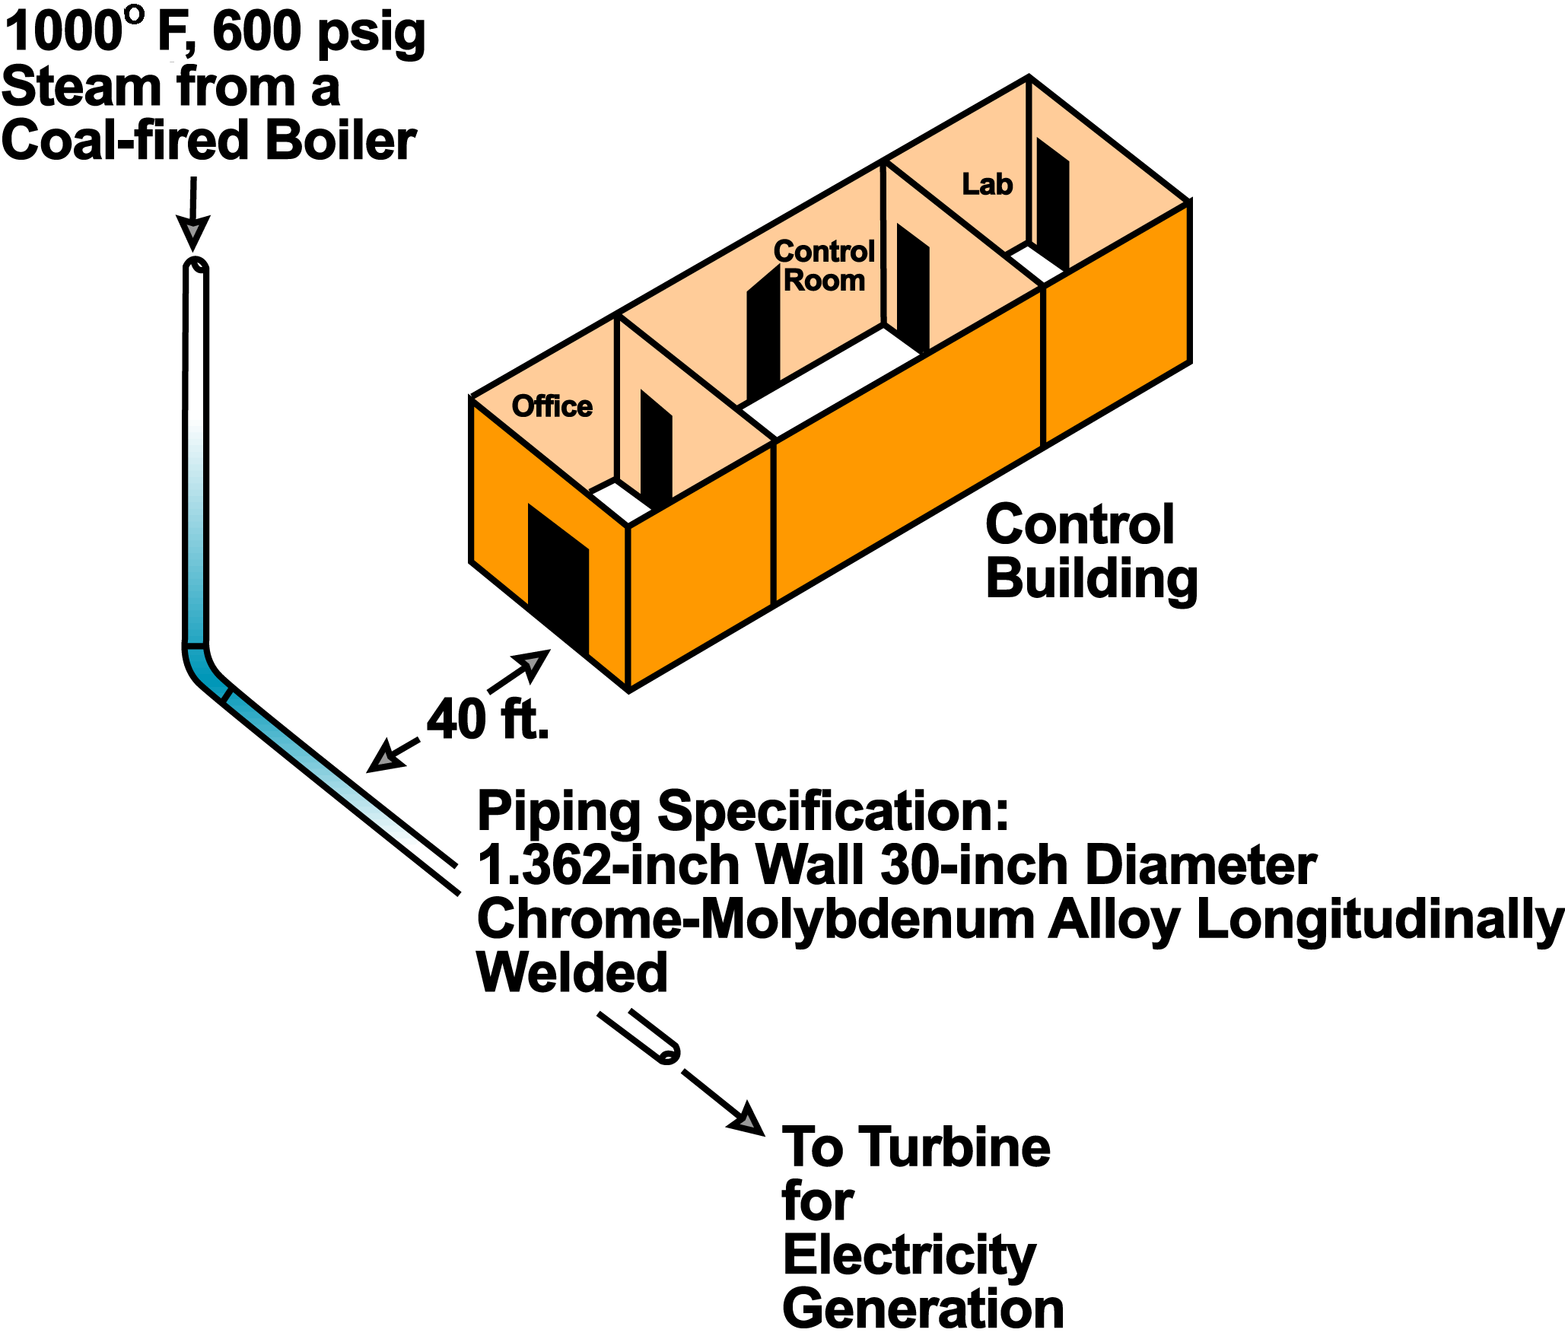
Workshop 4 – Quality Assurance

Slide 17
Workshop # 5 PSSR Pre-Start up Safety Review
- 17 -

Slide 18
Workshop 5 – Prestart-up Safety Reviews (PSSR)
Situation:
You are a plant process engineer assigned to project liaison with an engineering team (either internal–corporate or external-contract) responsible for the design, procurement, and installation of a project for manufacturing a new explosive. Plant people will be entirely responsible for start-up of the new plant, which has separate production, maintenance, and technical organizations.
The design of the process is complete and start-up is only two months away. Recent technical information on the liquid sensitizer (an organic amine nitrate) used in the explosive formulation shows its sensitivity to heat and friction is greater than previously recognized.
As a result,, a design change to a pump tank in the project has been made. The impeller may rub the casing when starved for liquid. Because of this, a low-low level interlock is to be added to the controls shown for the pump tank. The interlock will shut off the pump motor.

Slide 19
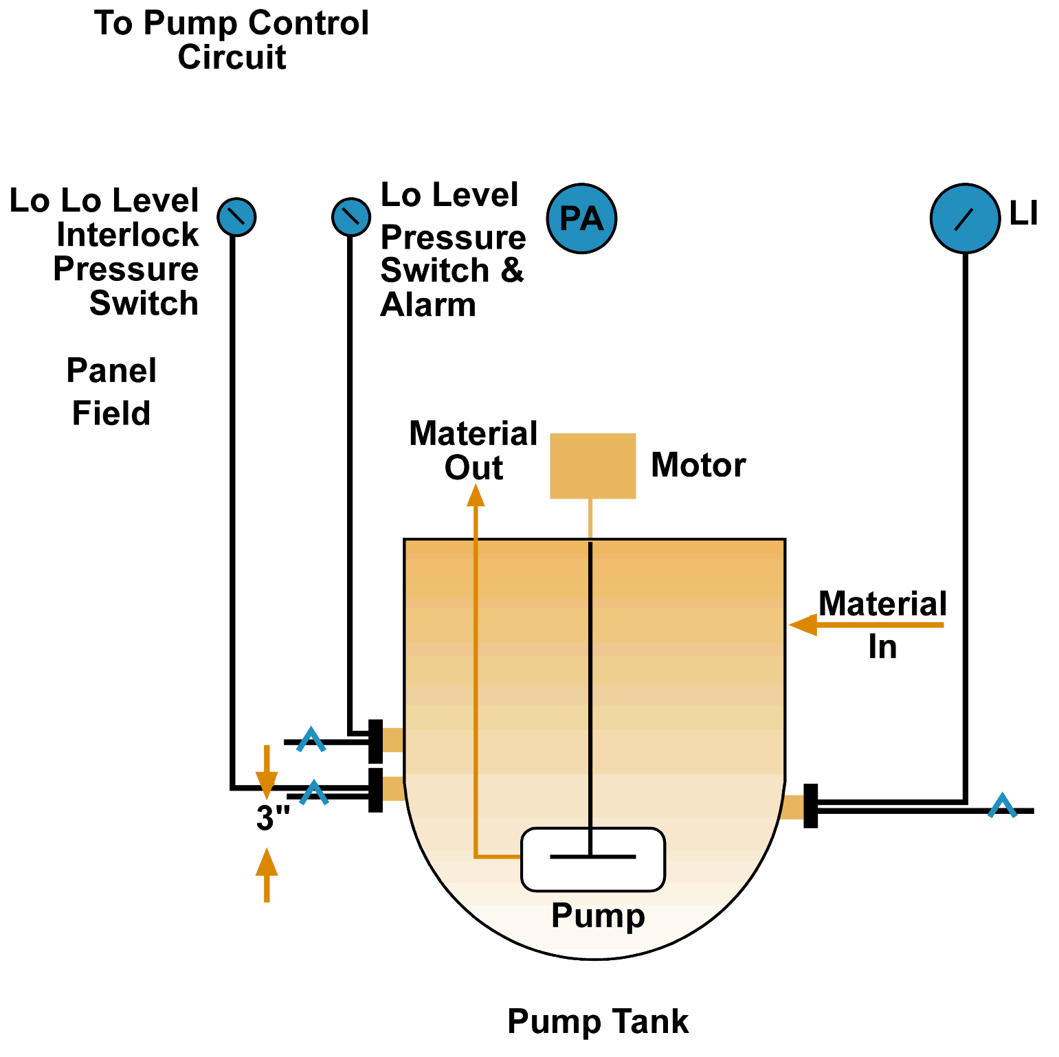
Sensitizer Pump Tank
Workshop 5 – Prestart-up Safety Reviews
Problem:
What items would you look for in a PSSR?
Group Discussion 20’

Slide 20
Workshop # 6 MI Mechanical Integrity
- 20 -

Slide 21
Workshop 6 – Mechanical Integrity (MI)
Situation:
You are an operations unit manager for a plastics plant that uses Dowtherm® as heat transfer agent.
As a result of a PHA, a new interlock of the fuel oil supply to the Dowtherm vaporizer is being installed during the annual plant turnaround, as shown in the sketch.
Low liquid level in the top vaporizer drum will cause the shutoff valve to close. This interlock was proposed when the review team realized that, at low liquid levels, tube wall temperatures could rapidly approach 1000°F (537°C).
They also recognized that Dowtherm decomposes to low boiling compounds above 850°F (454°C) and carbonizes in the tubes, lowering heat transfer and overheating the tube wall even faster.

Slide 22
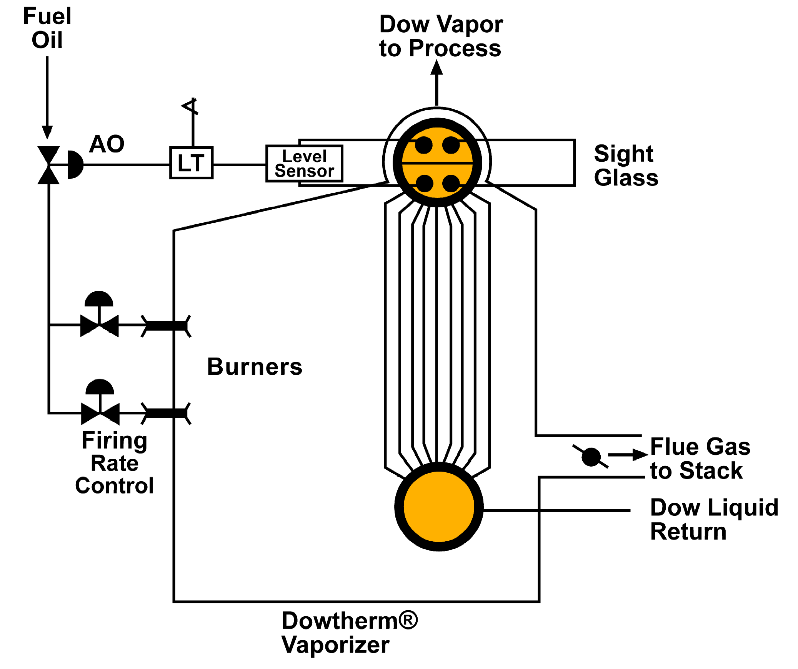
Dowtherm Vaporizer
Workshop 6 – Mechanical Integrity
Problem:
The team recommended that the interlock be functionally checked every six months. Outline the important points you think should be included in a detailed procedure for testing this interlock.
What should have been done?
Group Discussion 20’

Slide 23
Workshop # 7 MOC-Subtle Management Of Change - Subtle
- 23 -

Slide 24
Workshop 7 – Replacement-In-Kind (MOC - Subtle)
Situation:
You are an operations superintendent in the organic chemical manufacturing area. A 1000-gallon, glass-lined vessel is used in your area for the batch manufacture of an organic fine chemical.
During a maintenance shutdown, a mechanic drops a wrench into the vessel, severely damaging the glass lining.
Replacement of the vessel is essential before start-up to ensure product quality. The plant purchasing group locates a 1000-gallon, glass-lined vessel at a vendor’s site. The vessel has all the nozzles necessary to permit tie-in of process, service, and relief devices. The steel and glass coating are identical, as are the pressure ratings of both the vessel and the jacket.
The vessel is being shipped to your plant as a replacement.

Slide 25
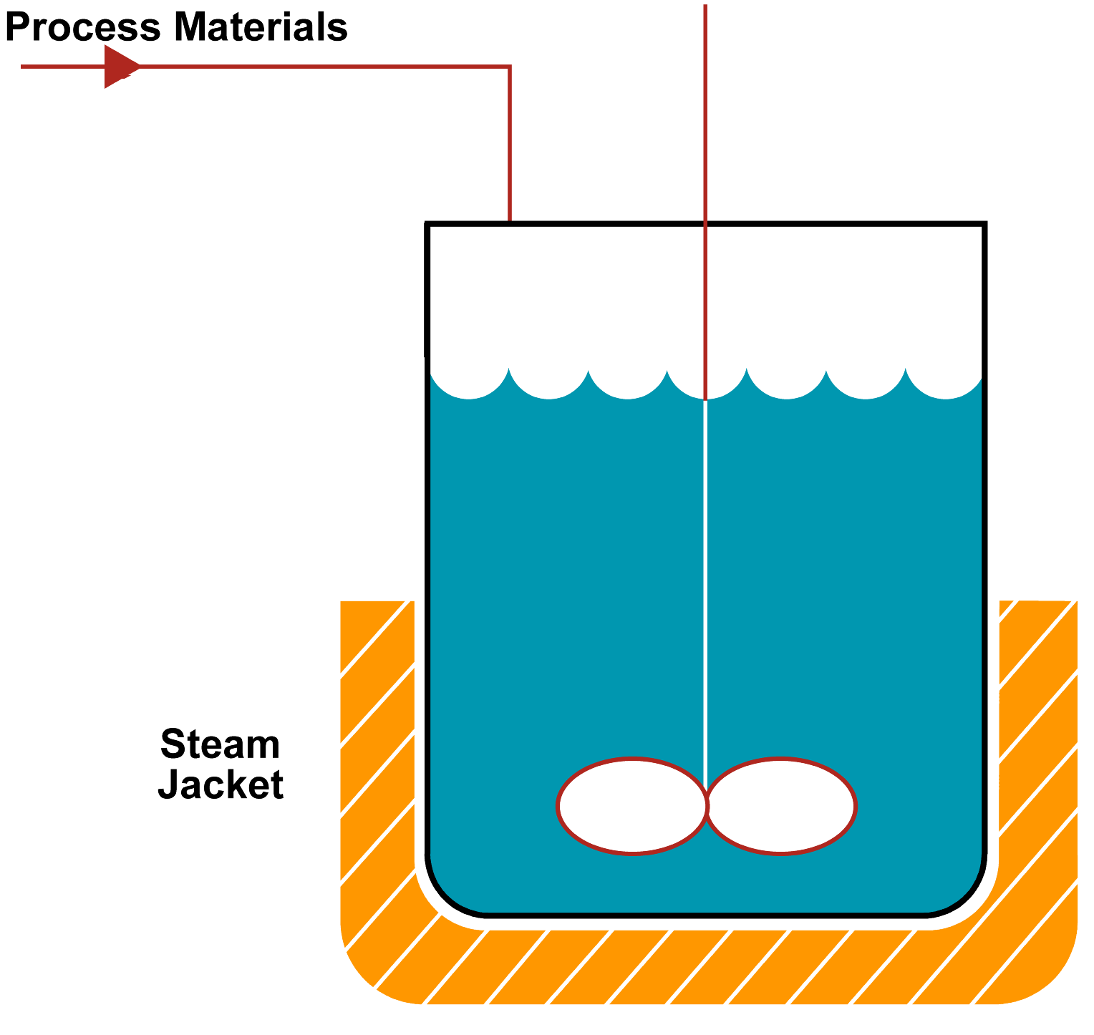
Glass Lined Reactor
Workshop 7 – Replacement-In-Kind
Problem:
Is a TA needed?
If yes, why?
Is a PHA needed?
If yes, why?
What are the difference
of two equipment?
Group Discussion 20’

Slide 26
Workshop # 8 MOC-P Management Of Change-People
- 26 -

Slide 27
Workshop 8 – Heptane Recovery (MOC - P)
Situation:
You are an operations supervisor of the Heptane recovery area, having been promoted to this assignment from process engineer in a plastics compounding operation at another site.
You have been in your new assignment about three months.
The plant has been undergoing an number of business changes since you arrived.
Because of start-up of a new process in another part of the plant,
you have lost two of your four first line supervisors.
Who have been replaced with two operator upgrades.

Slide 28
Workshop 8 – Heptane Recovery
Your boss has recently moved laterally into her job from the corporate office, where she was on special assignment studying production scheduling.
This operation is in a closed building.
Heptane vapors have been venting periodically from a 12-inch water-seal funnel in the water addition leg to the heptane-water decanter.
This just started happening within the last 16 hours and is happening about twice a shift.
You have read about this in the shift notes but have not witnessed it yourself.

Slide 29
Workshop 8 – Heptane Recovery
Your boss comes into your office just as you are leaving to attend a meeting of the off-plant safety committee that you chair.
She says:
Jim Poston (one of the new first-line supervisors) saw me this morning as he was leaving his shift and mentioned that Heptane was burping form the water-seal funnel.
He knows we are behind our production schedule for the month and suggested a way we could stop the burping until we have time to investigate further.
He suggested that we increase the height of the seal to 72 inches.
He also suggested that possibly process engineering could follow this on shift as an added precaution. Sounds like a good quick fix to me. How about following up on it today. If we can get it done within about an hour, we can still load that truck you committed to ship tomorrow morning.

Slide 30
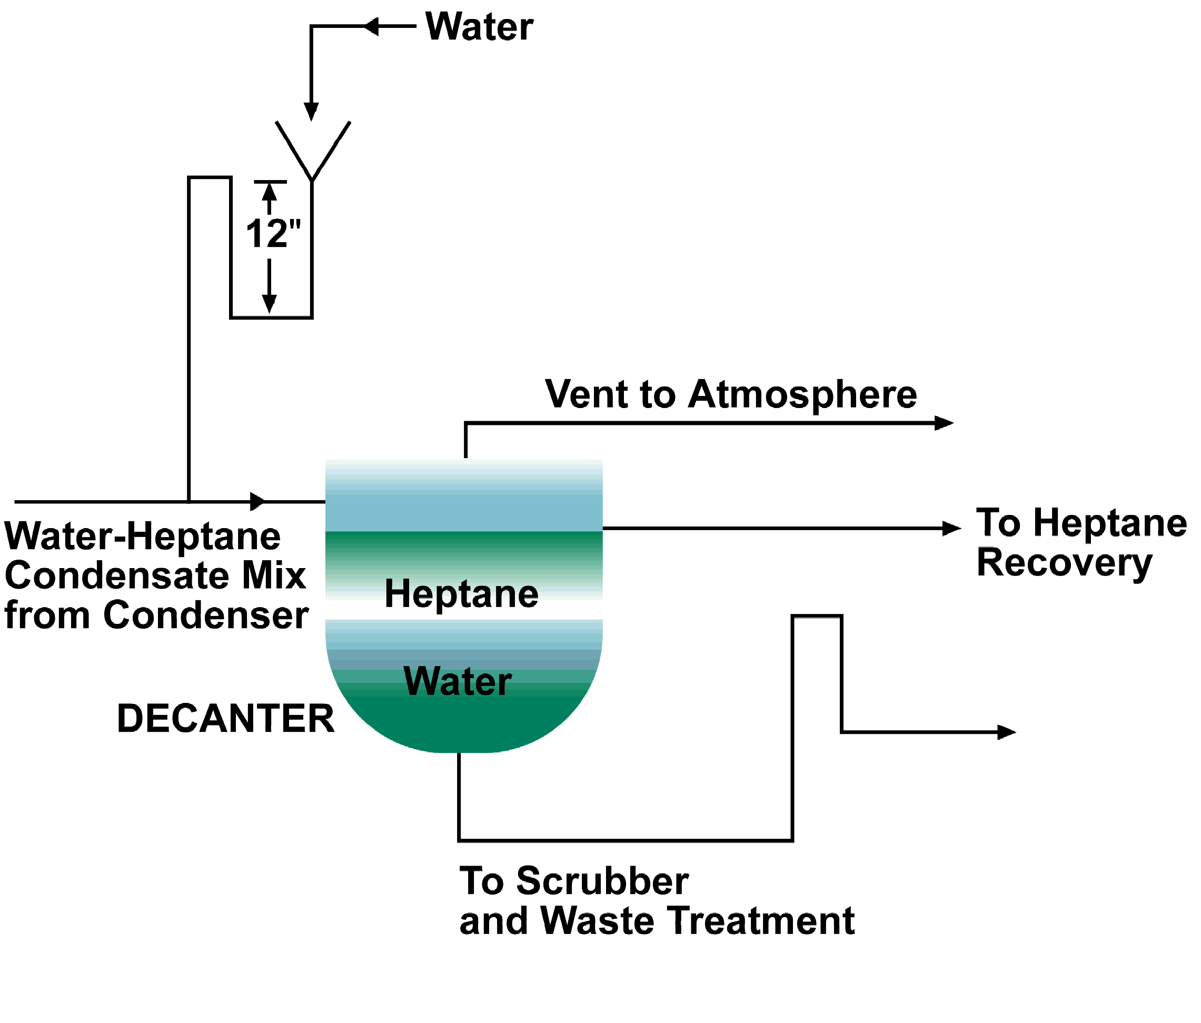
Workshop 8 – Heptane Recovery
Problem: How would you respond to this request?
Group Discussion 20’

Slide 31
Workshop # 9 Auditing
- 31 -

Slide 32
Workshop 9 – Auditing (Auditing)
Situation: You are the maintenance supervisor for a Toluene packaging operation. As a result of a recent Toluene spill that caused on-plant groundwater contamination, a PHA was completed with you as a team member.
The incident investigation revealed that the drum-filling operator had momentarily left the area during the once-per-day filling of the supply tank. On returning, the operator had found Toluene spilling from the conservation vent onto the ground.
Among other items, the PHA Team recommended that a high level interlock system be installed on the day tank as a back-up to the manual control by the operator.
The recommendation was accepted by the line organization.

Slide 33
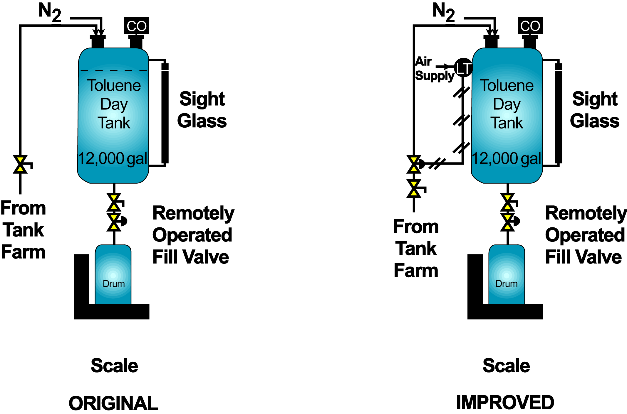
Workshop 9 – Auditing

Slide 34
Workshop 9 – Auditing
Problem: Maintenance is in the process of turning over the newly installed interlock to Operations.
What steps would you recommend be taken to ensure that this equipment remains as reliable as when first installed ?
Suggestion :
Consider both routine testing of the interlock and auditing of the test and usage of the interlocks.
Also, consider “who” should do “what” on what “frequency” for both testing and auditing.
Group Discussion 20’

Slide 35
For the safe world,
Work Together
With Warm Heart

